Slide 1




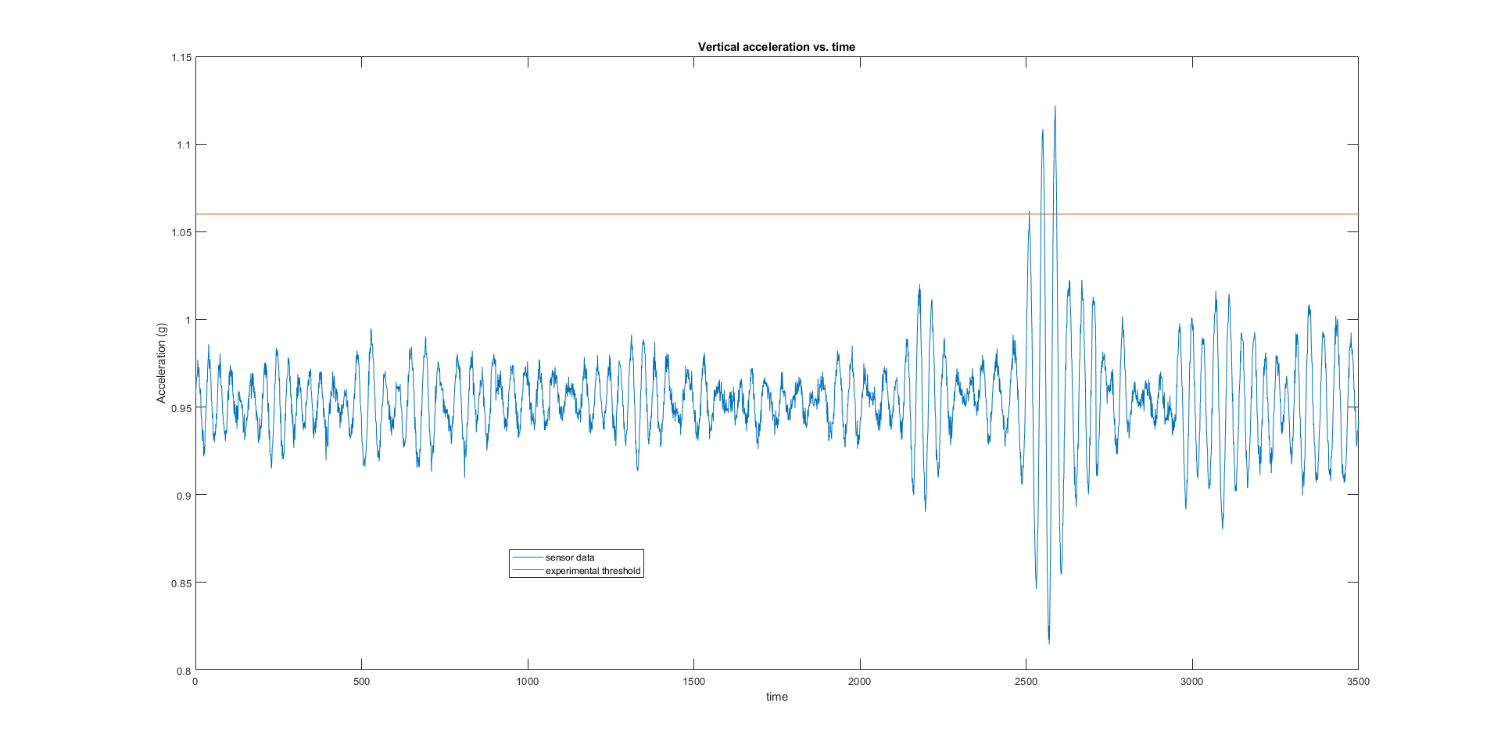
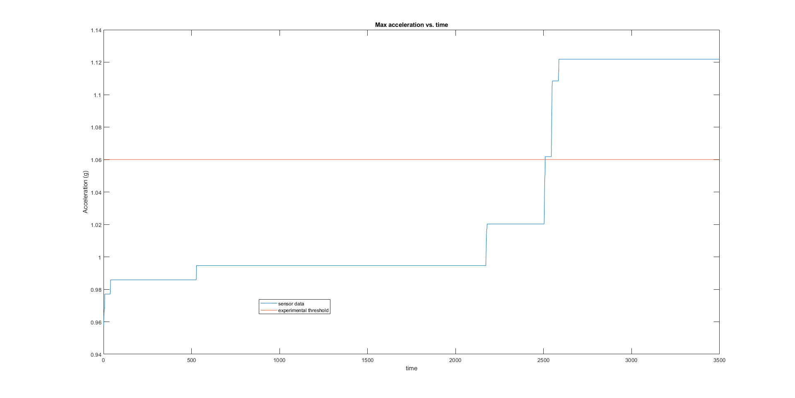
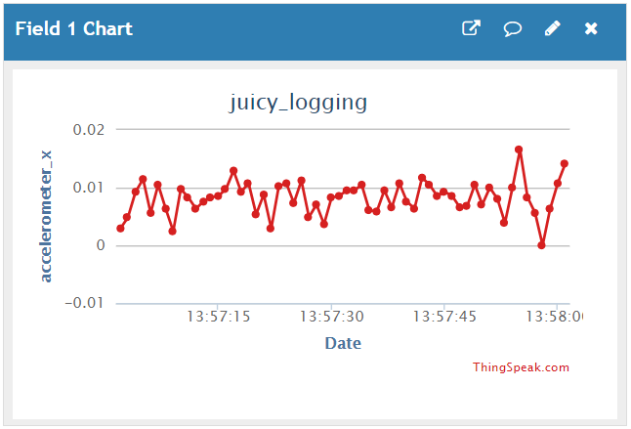
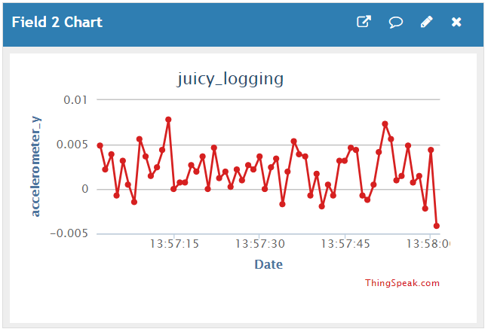
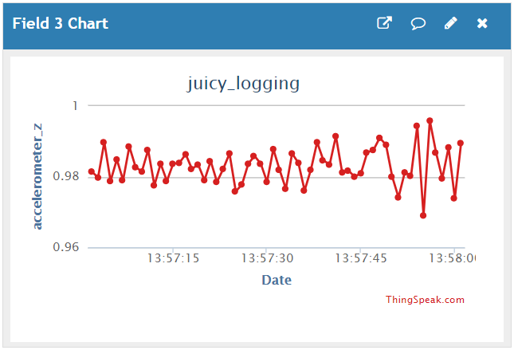
Software
Detection and Response
Program Design
Notifications
Initialize Data Comparison Value
Compare Sensor Data to Threshold
Update Comparison Value
Can send multiple kinds of notifications
Twilio
- calls and texts
- pricy but has desirable features
Pushetta
- app notifications
- free but is less developed
Send Alarm
Wait 15 s
Wait for Reset
Threshold Calibration
Data Acquisition
Wireless data logging with MathWorks’ ThingSpeak
- little interaction required and real time logging
- sped up testing phase
960 samples/second from accelerometer
- thresholds determined from this data
File storage on Raspberry Pi
- used to provide better timing information
- difficult to change during test
Notes:
Wireless data logging with MathWorks’ ThingSpeak
- little interaction required and real time logging
- sped up testing phase
960 samples/second from accelerometer
- thresholds determined from this data
File storage on Raspberry Pi
- used to provide better timing information
- difficult to change during test

